Slide 1

Chapter 6
Fractions
Click to start

Slide 2
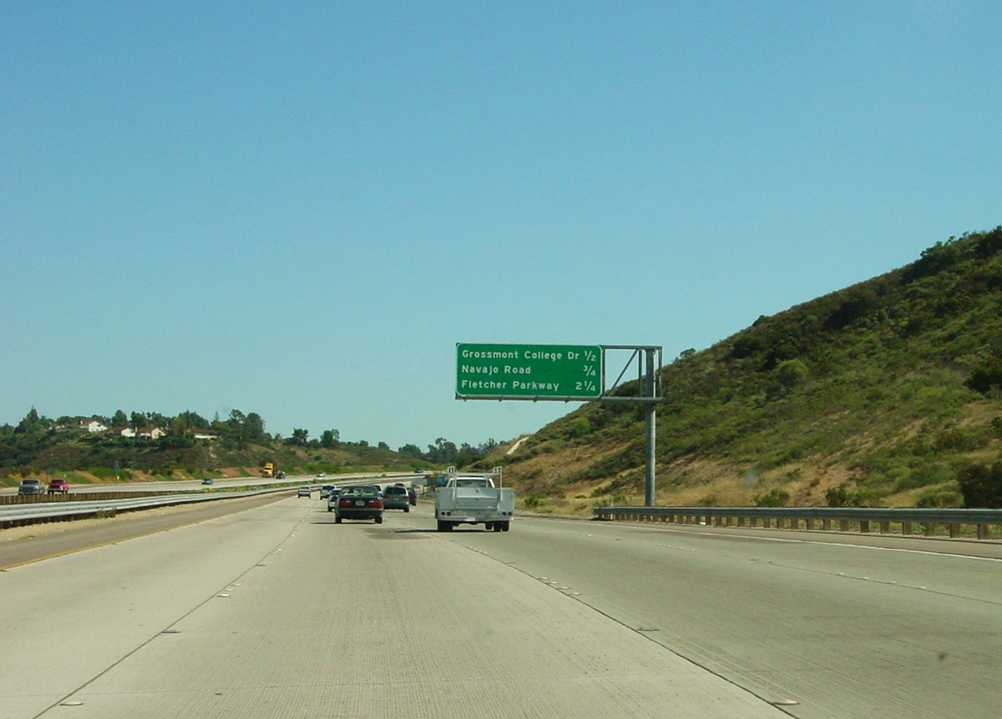
Fractions in our lives

Slide 3
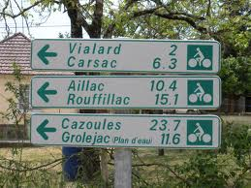

Slide 4
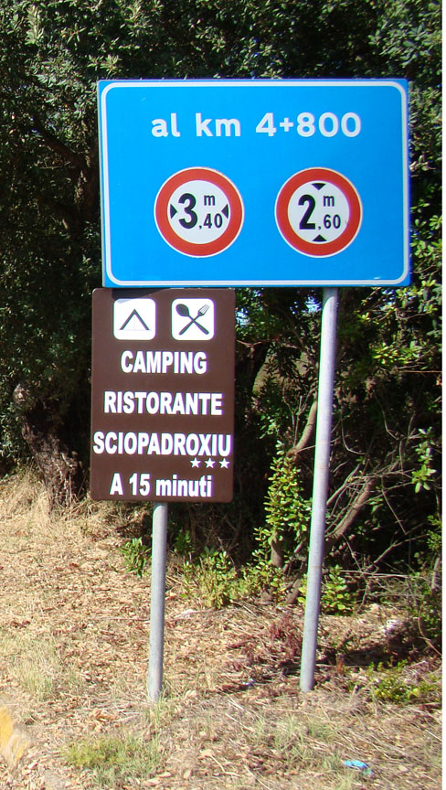

Slide 5
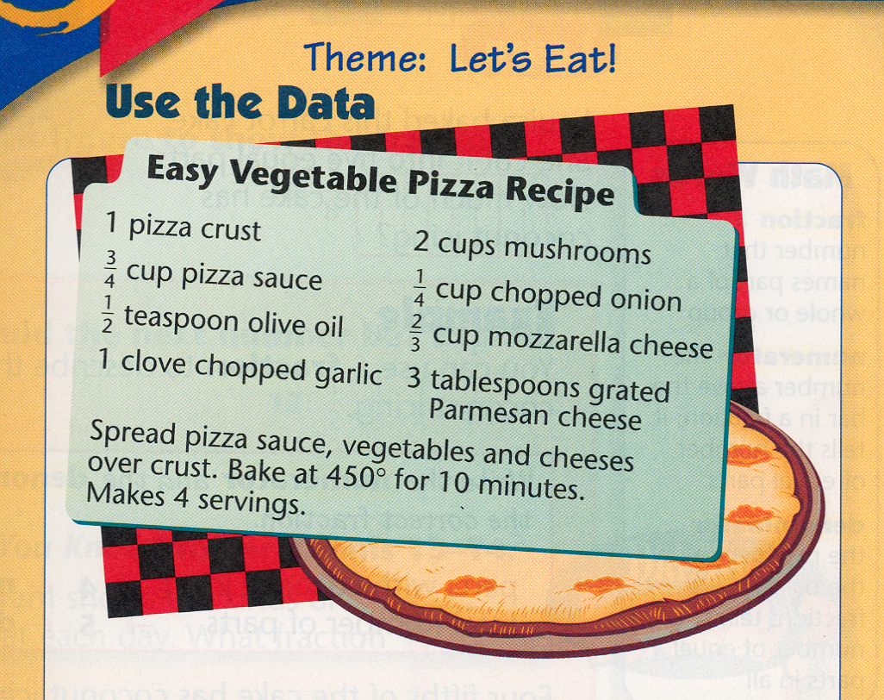
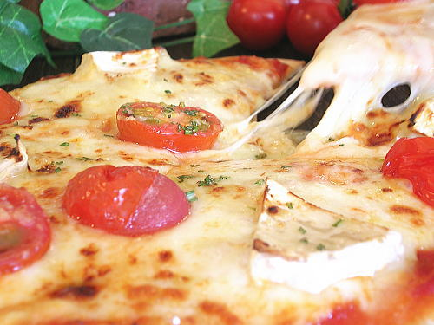
You will see fractions in almost every recipe.

Slide 6
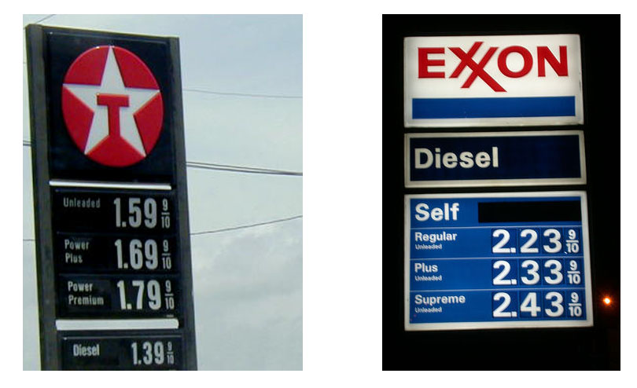
Gasoline prices are usually indicated with a fraction at the end, even though a decimal point is already used. Don’t know why.

Slide 7
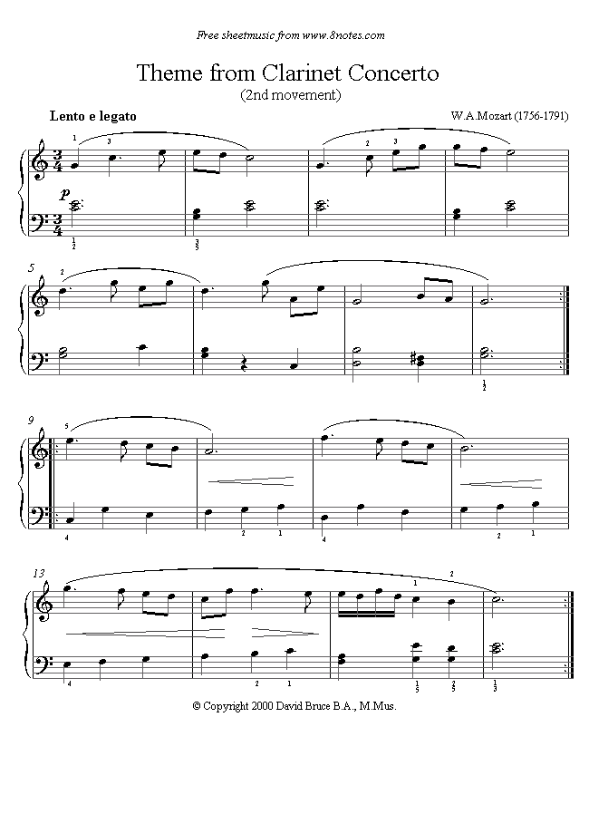
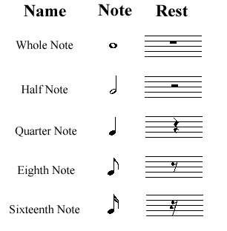
Fractions are also used in musical scores.
For example, we have many different kinds of notes, and each note has a specific duration.

Slide 8
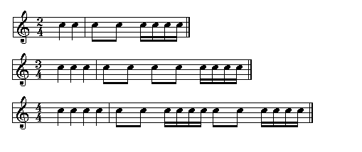
The time signature in a musical composition (which is the regular recurring pattern of strong and weak beats of equal duration) is indicated by a fraction, and is located at the beginning of a piece of music. The lower number of the fraction tells what kind of note receives one beat. The upper number tells how many beats are in a measure.

Slide 9
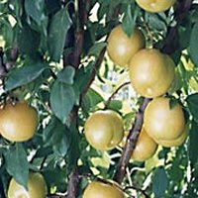
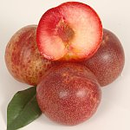
Even in agriculture, we can see fractions
Pluot (plü-ot) is a trade name for a fruit developed in the late 20th century by Floyd Zaiger, in Modesto, CA.
It is a complex cross hybrid of plum and apricot. More precisely
of the parents of pluot is plum and
of the parents of pluot is apricot
Plum + Apricot = Pluot
It naturally exhibits more plum-like traits.

Slide 10

Section 6.1
The Set of Fractions

Slide 11
What is a fraction?
Originally, a fraction means a fragment or a broken piece. Hence logically any number that does not represent a whole was called a "fraction".
In common usage, a fraction is assumed to be a number less than 1, but as we shall see, a number bigger than 1 can also be a fraction according to our mathematical definition.

Slide 12
Analyst: China's coronavirus victims 'probably 10 times' higher than reported
‎January‎ ‎27‎, ‎2020‎ ‎7‎:‎58‎ ‎AM
As global health officials grapple with arresting the virus’ spread, Meekins told “The Ticker” on Friday that “Based on conversations I’ve had with individuals both in the U.S. government and more importantly [in China] is that the number that have been reported out of China on this disease are really a fraction of the number of people who have probably had the disease.”
See, the “fraction” here is assumed to be a number less than 1.

Slide 13
Definition:
A fraction is an ordered pair of whole numbers, the 1st one is usually written on top of the other, with a line between them (either horizontally or on a slant), such as ½ or ¾ .
numerator
denominator
The denominator tells us the number of congruent pieces the whole is divided into, thus this number cannot be 0.
The numerator tells us the number of such pieces being considered.

Slide 14

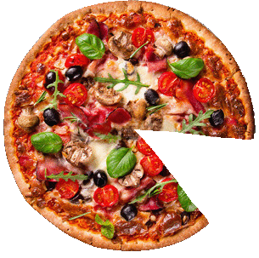
Example 1:
How much of a pizza do we have below?
The blue circle is our whole.
if we divide the whole into 8
congruent pieces,
- the denominator would be 8.
We can see that we have 7 of these pieces.
Therefore the numerator is 7, and we have
of a pizza.
7
8

Slide 15

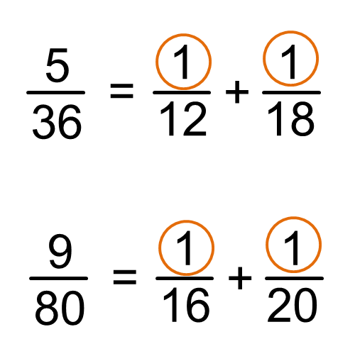
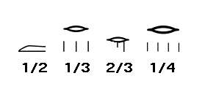
Historical Notes
Egyptians used fractions as early as 1600 BC, but they used mostly unit fractions, i.e. fractions with 1 as the numerator. The only exceptions are 2/3 and ¾ due to the frequent usage.
1/10 1/100

Slide 16
Historical Notes
Roman fractions are very different from their whole numbers. Even though the Roman system used base ten, the Roman fractions were based on twelfths, or multiples or divisions of twelfths. The 1/12 fraction itself was vncia, from which we derive words like “inch” (1/12 of a foot) and “ounce” (1/12 of a troy pound).
1/12 | 7/12
2/12 | 8/12
3/12 | 9/12
4/12 | 10/12
5/12 | 11/12
6/12 | 1/24

Slide 17

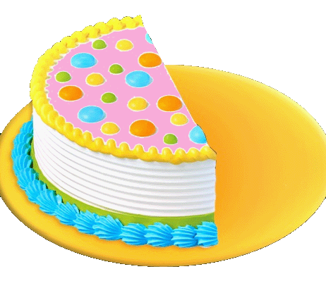
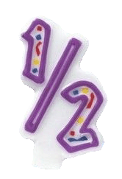
Equivalent fractions
a fraction can have many different appearances, these are called equivalent fractions
In the following picture we have ½ of a cake because the whole cake is divided into two congruent parts and we have only one of those parts.
But if we cut the cake into smaller congruent pieces, we can see that
1
2
=
2
4
Or we can cut the original cake into 6 congruent pieces,
candle

Slide 18
Equivalent fractions
a fraction can have many different appearances, these are called equivalent fractions
Now we have 3 pieces out of 6 equal pieces, but the total amount we have is still the same.
Therefore,
1
=
2
=
3
2
4
6
If you don’t like this, we can cut the original cake into 8 congruent pieces,

Slide 19
Equivalent fractions
a fraction can have many different appearances, these are called equivalent fractions
then we have 4 pieces out of 8 equal pieces, but the total amount we have is still the same.
Therefore,
1
=
2
=
3
=
4
2
4
6
8
We can generalize this to
1
1
×
=
n
whenever n is not 0
×
2
2
n

Slide 20

How do we know that two fractions are the same?
we cannot tell whether two fractions are the same until we reduce them to their lowest terms.
A fraction is in its lowest terms (or is reduced) if we cannot find a whole number (other than 1) that can divide into both its numerator and denominator.
Examples:
6
is not reduced because 2 can divide into both 6 and 10.
10
35
is not reduced because 5 divides into both 35 and 40.
40

Slide 21

How do we know that two fractions are the same?
More examples:
110
is not reduced because 10 can divide into both 110 and 260.
260
8
is reduced.
15
11
is reduced
23
To find out whether two fraction are equal, we need to reduce them to their lowest terms.

Slide 22
How do we know that two fractions are the same?
Examples:
Are
14
and
30
equal?
21
45
14
reduce
14
÷
7
=
2
21
21
÷
7
3
30
reduce
30
÷
reduce
÷
5
=
6
6
3
=
2
45
45
÷
÷
5
9
9
3
3
Now we know that these two fractions are actually the same!

Slide 23
How do we know that two fractions are the same?
Another example:
Are
24
and
30
equal?
40
42
24
reduce
24
÷
2
12
reduce
12
÷
4
3
=
=
40
40
÷
2
20
20
÷
4
5
30
reduce
30
÷
6
5
=
42
42
÷
6
7
This shows that these two fractions are not equal!

Slide 24

Improper Fractions and Mixed Numbers
An improper fraction is a fraction with the numerator larger than or equal to the denominator.
5
3
Any whole number can be transformed into an improper fraction.
4
9
4
=
,
1
=
1
9
3
A mixed number is a whole number and a fraction together
2
7
An improper fraction can be converted to a mixed number and vice versa.

Slide 25
Improper Fractions and Mixed Numbers
Converting improper fractions into mixed numbers:
divide the numerator by the denominator
the quotient is the leading number,
the remainder as the new numerator.
5
2
=
1
3
3
7
3
11
1
More examples:
=
=
1
,
2
4
4
5
5
3
2
×
+
Converting mixed numbers into improper fractions.
7
3
17
2
=
=
7
7
7

Slide 26

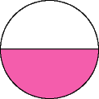
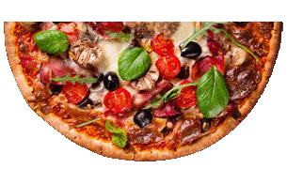
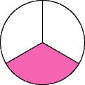
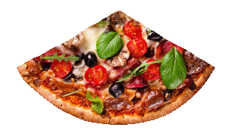
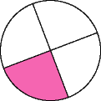
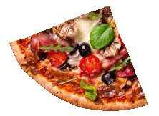
How does the denominator affect a fraction?
If you share a pizza evenly among two people, you will get
1
2
If you share the same pizza evenly among three people, you will get
1
3
If you share the same pizza evenly among four people, you will get
1
4

Slide 27

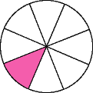
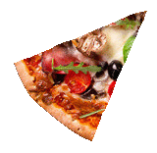
How does the denominator affect a fraction?
If you share the same pizza evenly among eight people, you will get only
1
8
It’s not hard to see that the slice you get becomes smaller and smaller.
Conclusion:
If the whole is kept fixed, the larger the denominator the smaller the pieces, and if the numerator is kept fixed, the larger the denominator the smaller the fraction,
a
a
i.e.
if
b
>
c
then
<
.
b
c

Slide 28
Examples:
Which one is larger,
2
2
2
or
?
Ans
:
7
5
5
Which one is larger,
8
8
8
or
?
Ans
:
23
25
23
Which one is larger,
41
41
41
or
?
Ans
:
135
267
135

Slide 29

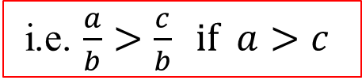
How does the numerator affect a fraction?
Here is ¹/₁₆ ,
here is ³/₁₆ ,
here is ⁵/₁₆ ,
Do you see a trend?
Yes, when the numerator gets larger, we have more pieces.
And if the denominator is kept fixed, the larger numerator makes a bigger fraction.

Slide 30
Examples:
Which one is larger,
7
Ans
:
12
Which one is larger,
8
13
13
or
?
Ans
:
20
20
20
Which one is larger,
45
63
63
or
?
Ans
:
100
100
100

Slide 31

Comparing fractions with different numerators and different denominators.
In this case, it would be pretty difficult to tell just from the numbers which fraction is bigger, for example
3
5
8
12
This one has less pieces but each piece is larger than those on the right.
This one has more pieces but each piece is smaller than those on the left.

Slide 32
3
5
8
12
One way to answer this question is to change the appearance of the fractions so that the denominators are the same.
In that case, all the pieces will be of the same size, and the larger numerator will make a bigger fraction.
3
6
9
5
10
=
=
and
=
8
16
24
12
24
Now it is easy to tell that 5/12 is actually a bit bigger than 3/8.

Slide 33

A more efficient way to compare fractions
Which one is larger,
From the previous example, we see that we don’t really have to know what the common denominator turns out to be, all we care are the numerators.
Therefore we shall only change the numerators by cross multiplying.
7
5
or
?
11
8
7
5
11
8
7 × 8 = 56
11 × 5 = 55
7
5
Since 56 > 55, we see that
>
11
8
This method is called cross-multiplication, and it must be done with the arrows going upward.

